Slide 1

Shadow Invariant Material Detection Using Hyperspectral Images
By
Kankipati Abishai(CS22B1030)
Research Supervisor Dr Dubacharla Gyaneshwar Assistant professor

Slide 2
CONTENTS
Introduction
Aim
Dataset
Methodology
Project Pipeline
Spectral Similarity Metrics
Results
Performance Metrics
Challenges
Conclusion

Slide 3
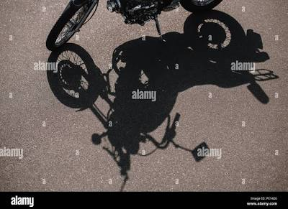
Introduction
Hyperspectral images provide high spectral information for accurate material identification.
Shadows introduce light variations that degrade classification performance
Traditional intensity-based methods fail under shadow conditions.
Material
Non-Material
Shadow
Figure 1

Slide 4

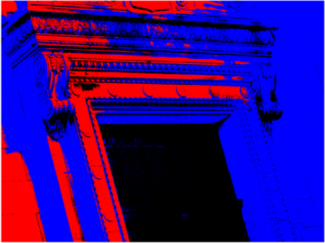



Aim
To develop a shadow-invariant material detection framework using hyperspectral images.
To accurately separate shadow and material regions under varying light conditions.
Shadow
Material
Non-Material
Figure 2a
Figure 2b

Slide 5
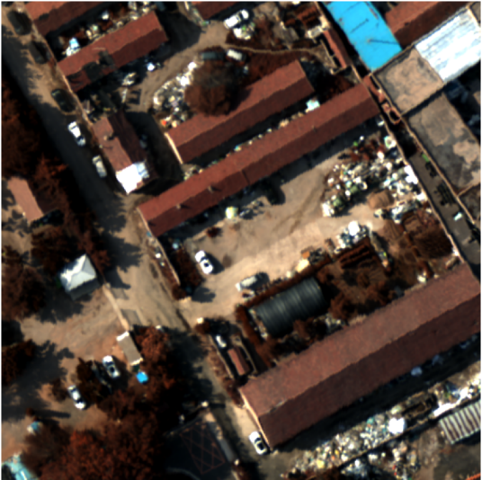
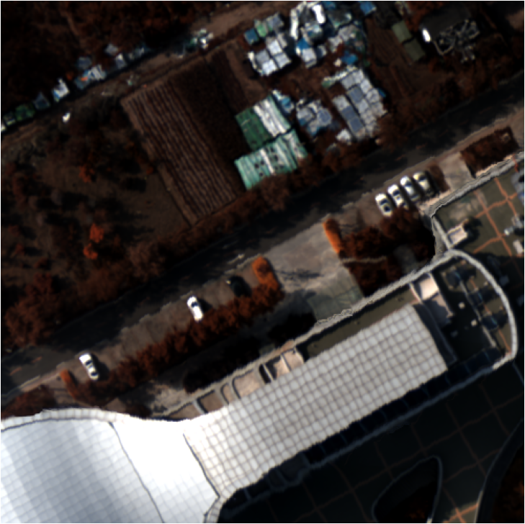
Datasets
Training Image:
Testing Image:
https://033labcodes.github.io/awesome-hyperspectral-datasets/
The training hyperspectral image used for collecting shadow and material spectral samples. Pseudo-RGB visualization helps in manual pixel selection for accurate ground truth labeling. | The testing hyperspectral image used to evaluate the trained model and adaptive thresholds under unseen shadow and light conditions.

Slide 6
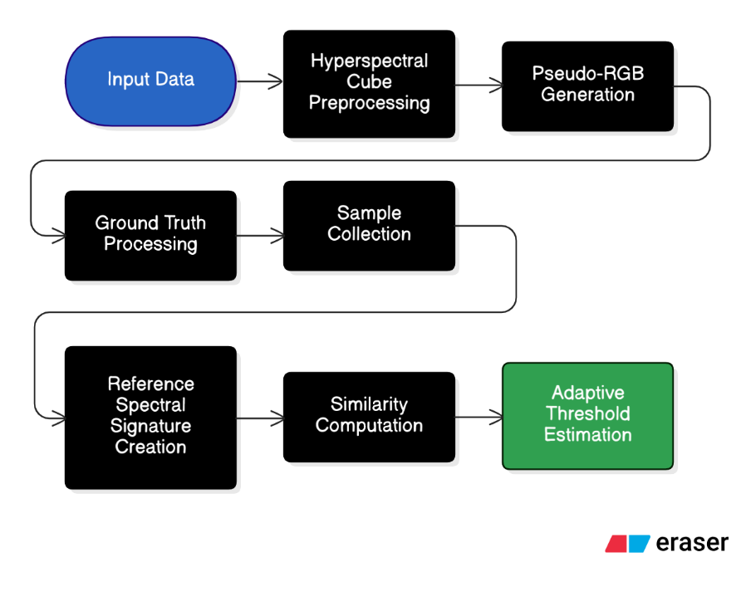

Project Pipeline
Training Phase:

Slide 7
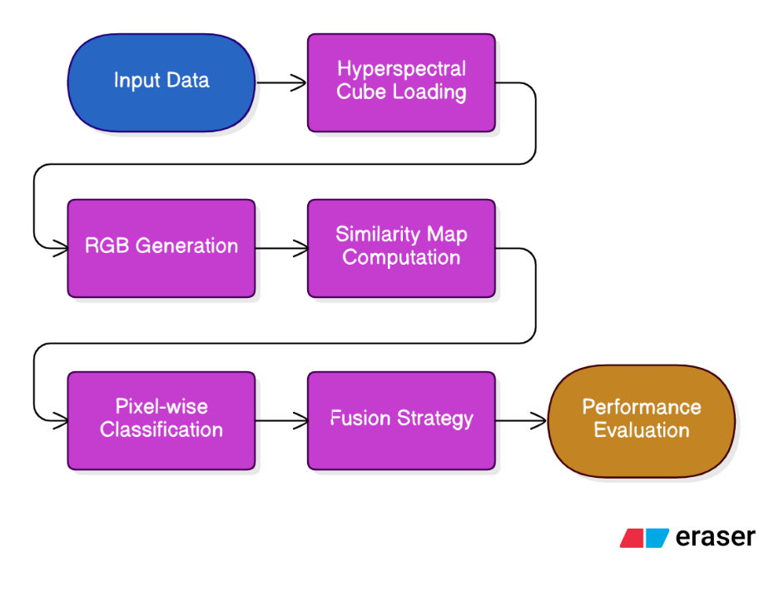
Project Pipeline
Testing Phase:

Slide 8
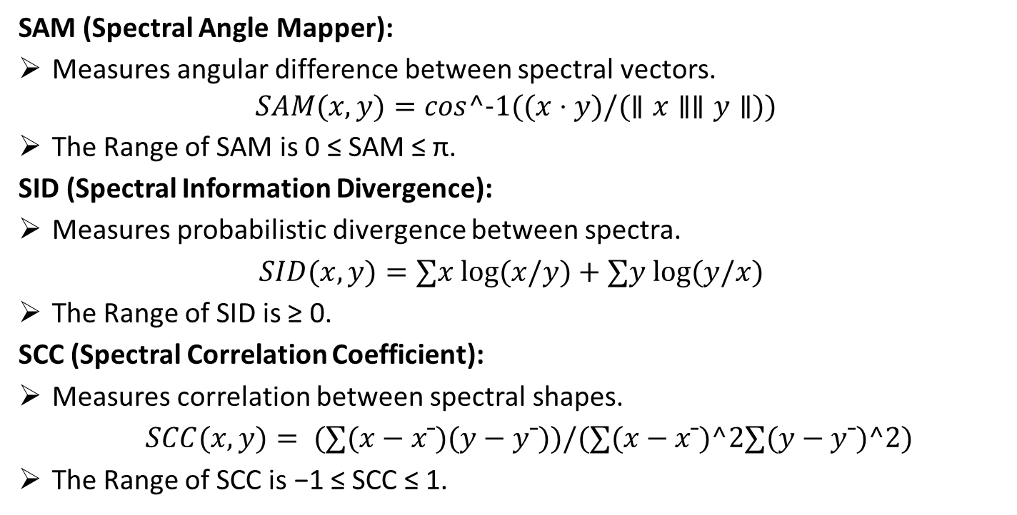
SPECTRAL SIMILARITY METRICS
SAM (Spectral Angle Mapper):
Measures angular difference between spectral vectors. $SAM(x, y)=cos^−1((x⋅y)/(∥x∥∥y∥))$
The Range of SAM is 0 ≤ SAM ≤ π.
SID (Spectral Information Divergence):
Measures probabilistic divergence between spectra.
$SID(x, y)=∑x log⁡(x/y)​+∑y log⁡(y/x)​$
The Range of SID is ≥ 0.
SCC (Spectral Correlation Coefficient):
Measures correlation between spectral shapes.
$SCC(x, y)= (∑(x−xˉ)(y−yˉ​))/(∑(x−xˉ)^2∑(y−yˉ​)^2​)​$
The Range of SCC is −1 ≤ SCC ≤ 1.

Slide 9
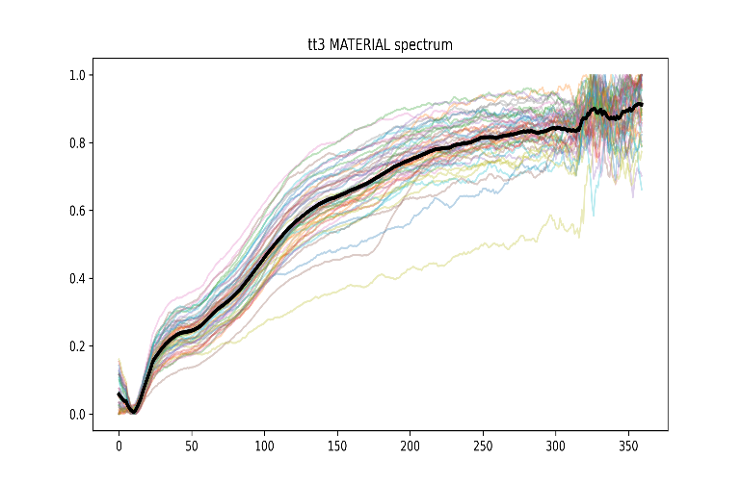
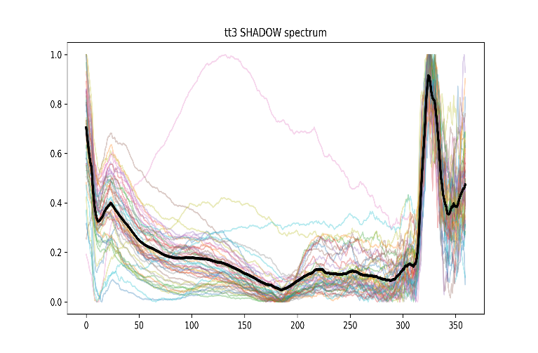
Results
Material vs Shadow Spectral Signatures:
Figure 3a
Figure 3b
Most material spectra follow a consistent increasing spectral signature, indicating stable material reflectance across bands. | Shadow spectral show significantly reduced spectral magnitude compared to material spectral.

Slide 10
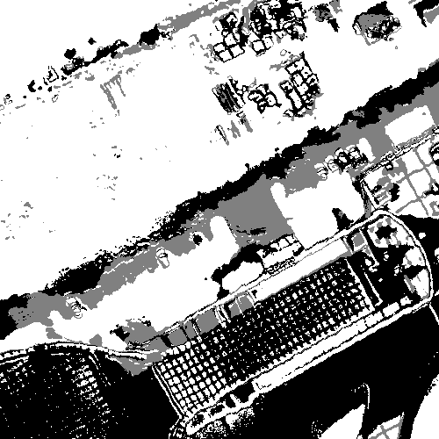
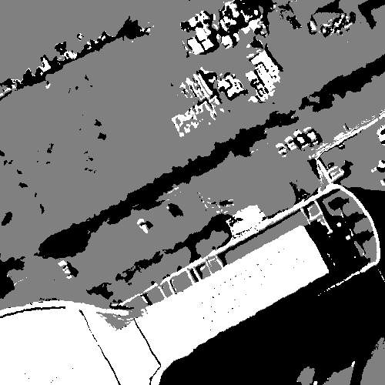
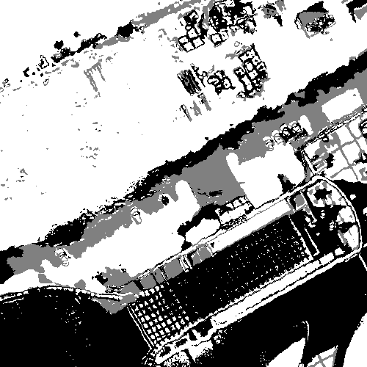
Results
SAM,SCC,SID Masks:
Figure 4a
Figure 4b
Figure 4c
Each similarity metric classifies pixels differently under shadow regions.
Individual masks show some misclassifications, especially in complex shadow areas.

Slide 11
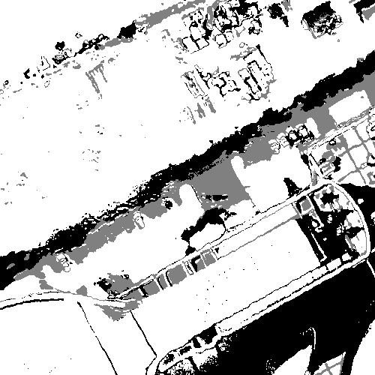
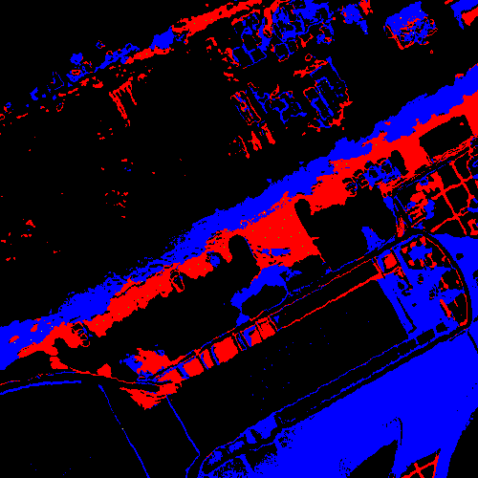


Results
Fusion vs Ground Truth Masks:
Shadow
Material
Non-Material
Figure 5a
Figure 5b
Fusion output aligns more closely with ground truth compared to individual metrics.
False detections are reduced by combining SAM, SID, and SCC decisions.

Slide 12
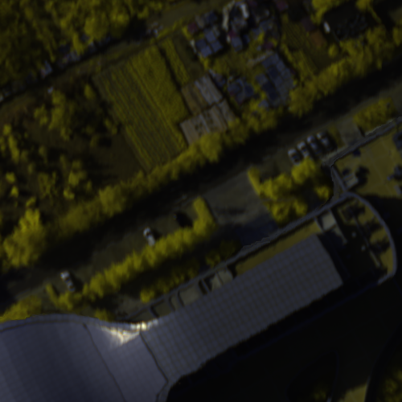
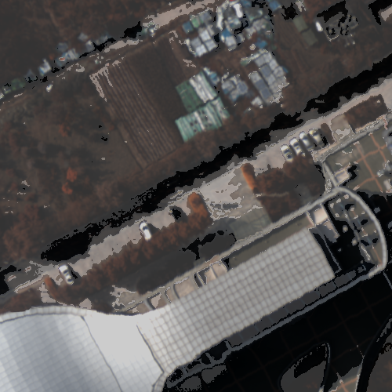
Results
True Colour and overlay Masks:
Figure 6a
Figure 6b
The fusion-based classification mask is overlaid on the pseudo-RGB image to visually measure detection accuracy.
Material regions remain constantly detected even under shadow, showing shadow-invariant behavior.

Slide 13
Performance Metrics
Methods | Accuracy | Precision | Re-Call | F1 Score
SAM | 0.744 | 0.001 | 0.68 | 0.003
SID | 0.740 | 0.001 | 0.68 | 0.003
SCC | 0.310 | 0.0004 | 0.902 | 0.0009
Fusion | 0.784 | 0.001 | 0.741 | 0.003

Slide 14
Challenges
Spectral similarity between shadow and material regions made single-metric classification unreliable.
Manual pixel selection for shadow and material samples was time-consuming.
Adaptive threshold selection was challenging due to changing spectral distributions across scenes.
Class imbalance between shadow and material pixels affected evaluation and required multiple metrics.

Slide 15
Conclusion
Spectral similarity metrics such as SAM, SID, and SCC effectively reduced the impact of light variations caused by shadows.
Fusion of multiple similarity metrics provided more reliable results than individual metric-based classification.
The proposed approach demonstrated accurate separation of shadow and material regions under different light conditions.

Slide 16
Thank you !

